Slide 2
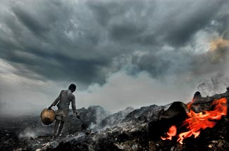
MATTHEW 10:28
‘Don’t be afraid of those who want to kill your body; they cannot touch your soul. Fear only God who can destroy both soul and body in Gehenna’

Slide 3
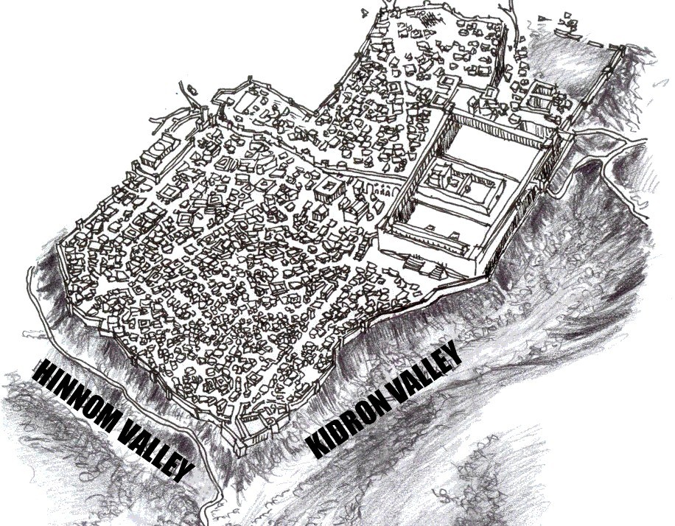

Slide 4
We make disciples because hell is real and Jesus is the answer.

Slide 5
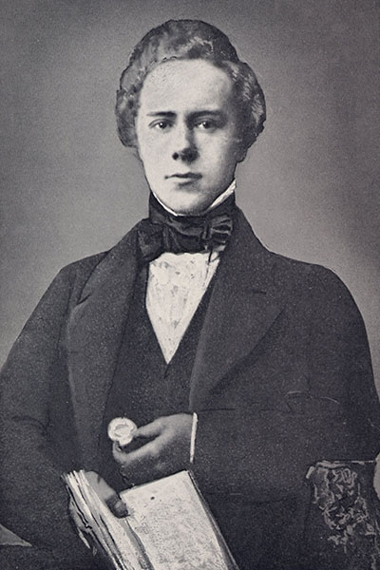

Slide 6
“Would that God make hell so real to us that we cannot rest;
Heaven so real that we must have men there.”
HUDSON TAYLOR

Slide 8
REVELATION 7:9-17
‘After this I saw a great crowd, too great to count, from every nation and tribe and people and language, standing in front of the throne and before the Lamb. They were clothed in white robes and held palm branches in their hands. And they were shouting with a great roar:
“Salvation comes from our God who sits on the throne and from the Lamb”

Slide 9
‘And all the angels were standing around the throne and around the elders and the four living beings. And they fell before the throne with their faces to the ground and worshipped God. They sang:
“Amen! Blessing and glory and wisdom and thanksgiving and honour and power and strength belong to our God forever and ever! Amen”

Slide 10
‘Then one of the twenty-four elders asked me, “Who are these who are clothed in white? Where did they come from?”
And I said to him, “Sir, you are the one who knows.”
Then he said to me, “These are the ones who came out of the great suffering. They have washed their robes in the blood of the Lamb and made them white.”

Slide 11
‘ “That is why they stand in front of God’s throne and serve Him day and night in His Temple.
And He who sits on the throne will give them shelter. They will never again be hungry or thirsty; They will never again be scorched by the heat of the sun. For the Lamb on the throne will be their Shepherd. He will lead them to springs of life-giving water. And God will wipe every tear from their eyes.” ’

Slide 12
Heaven is the place where God is present

Slide 13
Heaven is the place of perfect community

Slide 14
Heaven is the place where all creation is transformed

Slide 15
We make disciples because heaven is perfect.
“Would that God make hell so real to us that we cannot rest;
Heaven so real that we must have men there.”
HUDSON TAYLOR

Slide 16
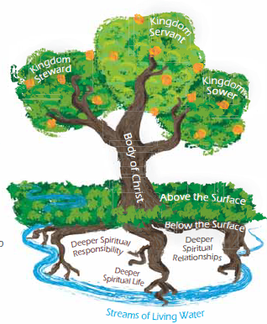

Slide 17
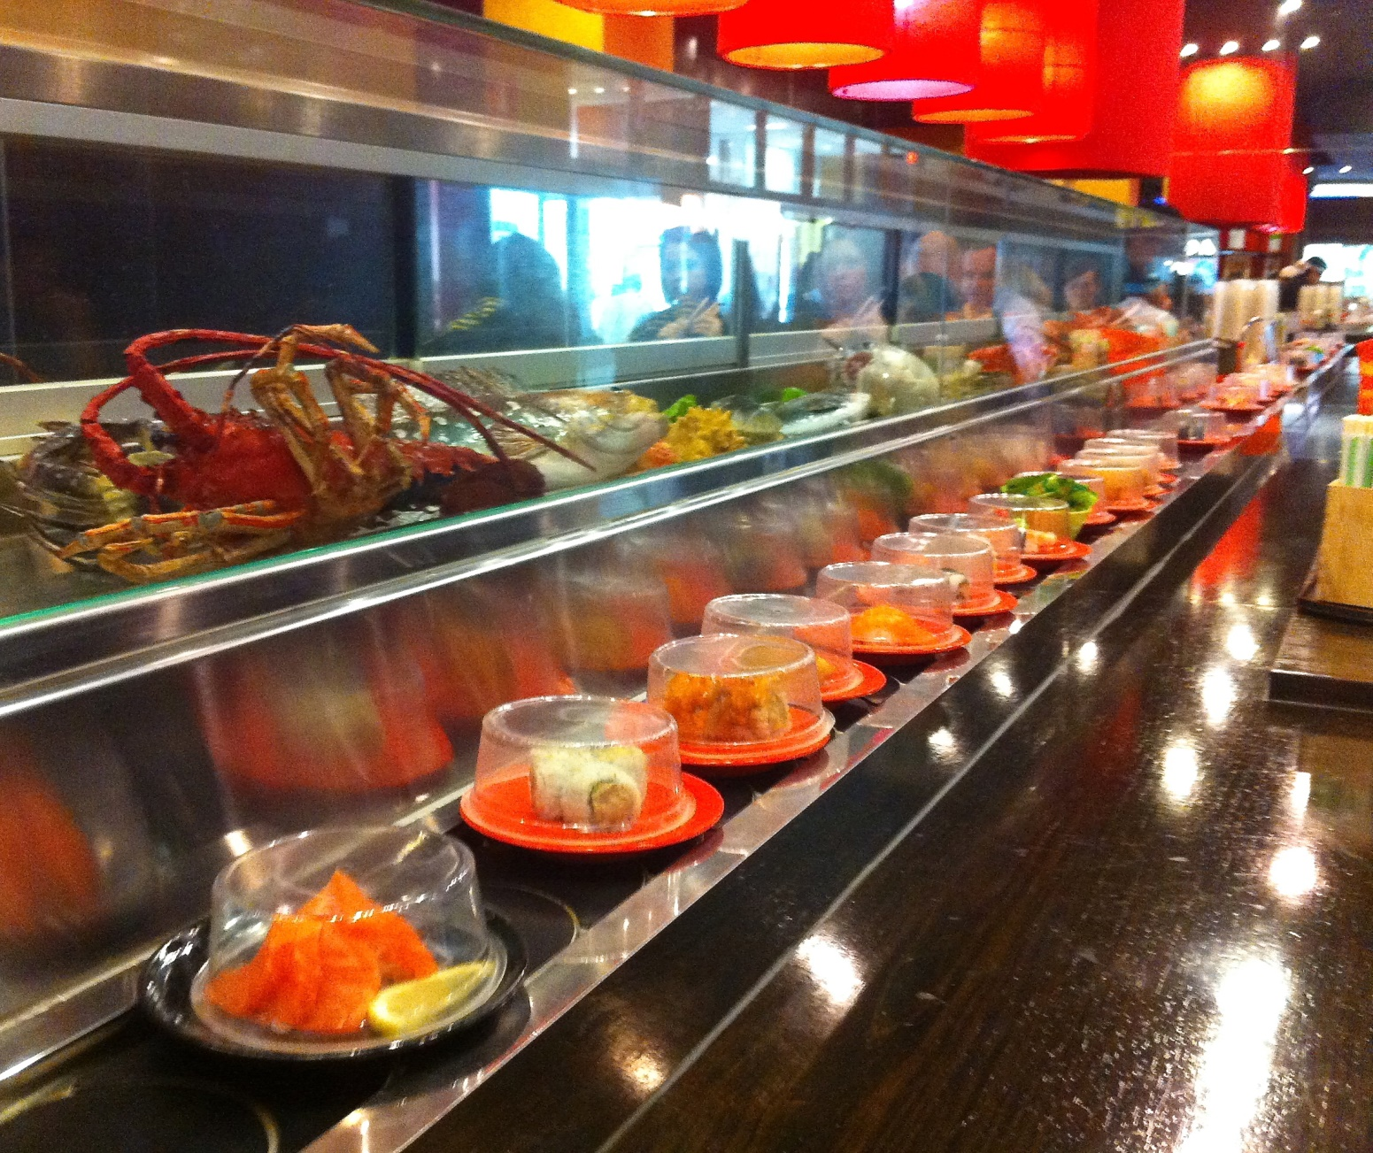

Slide 18
How does God want you to be involved?
1. Pray

Slide 21
Give

Slide 22
Go

Slide 23
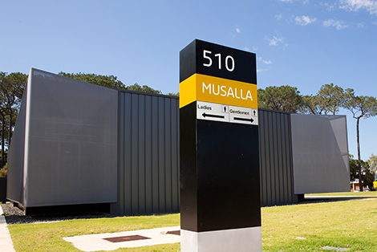
CURTIN UNIVERSITY

Slide 25
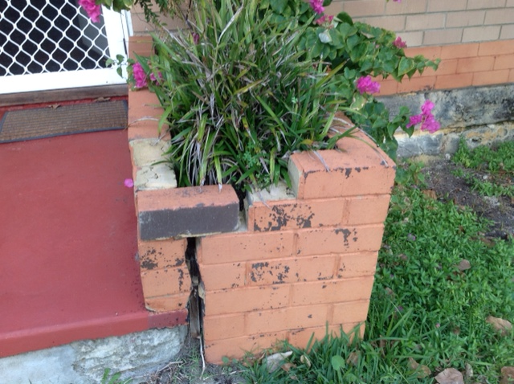
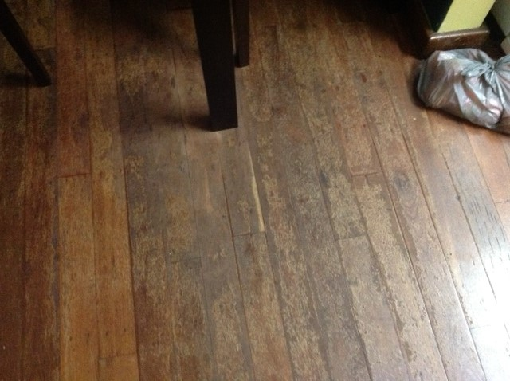
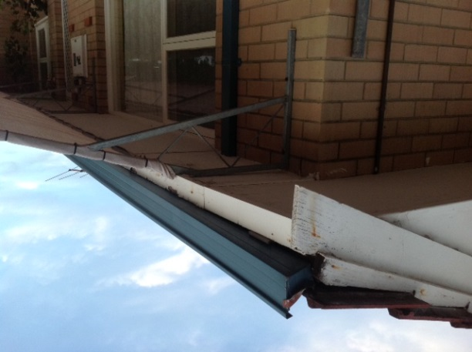
MISSIONS HOUSE

Slide 26
What does God want you to do?
Email:
luke.tassell@lifestreamscc.com
Text: 0412913466

